Slide 1
An Aggregator For Recommender Systems
Max Kirker Burton

Slide 2
What is aggregation?
The merging of two or more outcomes
Infinite different ways to aggregate
Notes:
Aggregation is simply the merging of two or more things, so that they can be represented by one value. In the case of recommendation systems, this means somehow merging the results of your recommendations into one unified list.
There are a never-ending list of permutations possible when it comes to aggregating. As such, while it is relatively easy to aggregate two things together, it is much more difficult to aggregate them well.

Slide 3
Why Aggregate?
More data, better recommendations
Ensemble recommenders are (usually) better
Better recommendations = happier users
Happier users = more sales
Could soon become very popular
Notes:
So, the first question we must ask ourselves is, why aggregate? The simplest reason is, more data, better recommendations. This is the case for any data science problem, and often the limiting factor to improving a learning model’s performance is the amount of useful data available. If we extend our scope beyond a single dataset, we suddenly have access to orders of magnitude more data.
Ensemble recommenders have also been shown to outperform their base algorithms. The netflix prize, which renewed research interest in recommender systems, was won in 2009 by the BellKor solution, which used a combination of 107 individual systems.
Imagine a third party service that knew all your watching habits and knew what to recommend you watch next, regardless of what platform the movie is hosted on. Ignoring the security implications, this would be tremendously useful as people often struggle finding things to watch. Extend this idea onto markets such as ecommerce and suddenly you have a whole new industry of third party recommenders.

Slide 4
Problems
How to represent users and items from different sources?
Can items be aggregated effectively across multiple differently structured datasets?
Can items be aggregated effectively when their outputs are different?
Notes:
There are of course a few problems we need to address before we can know if aggregation is a feasible concept.

Slide 5
Same Algorithm, Different Data Problem (SADD)
Simulate the problem by creating dataset splits
Each split represents a movie provider
Complete dataset acts as the golden list

Slide 6
Same Algorithm, Different Data Problem (SADD)
Splits can be created in several ways. We use:
Even
Random
Large vs Small
Dense vs Sparse

Slide 7
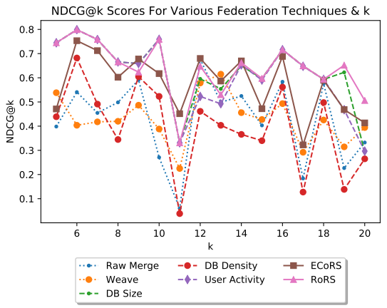
Same Algorithm, Different Data Problem (SADD)

Slide 8
Different Algorithm, Same Data Problem (DASD)
How do merge recommendations?
Algorithm Mapper
Gradient Boosting Regressor

Slide 9
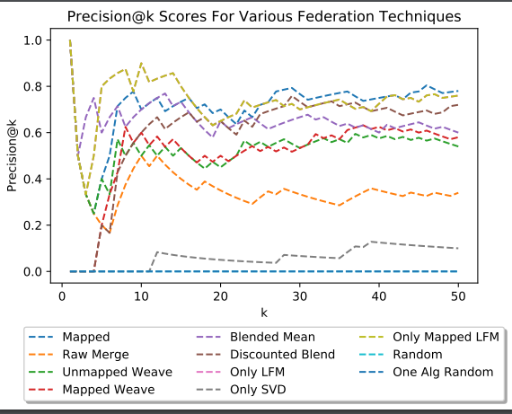
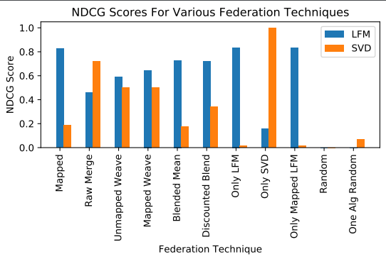
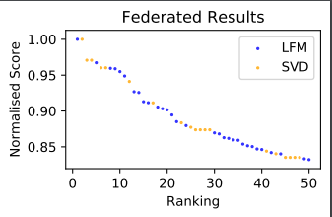
Different Algorithm, Same Data Problem (DASD)

Slide 10
Conclusion
Federation is not only feasible, but desirable
Further research should be done to build a ready for business federator

